Slide 1

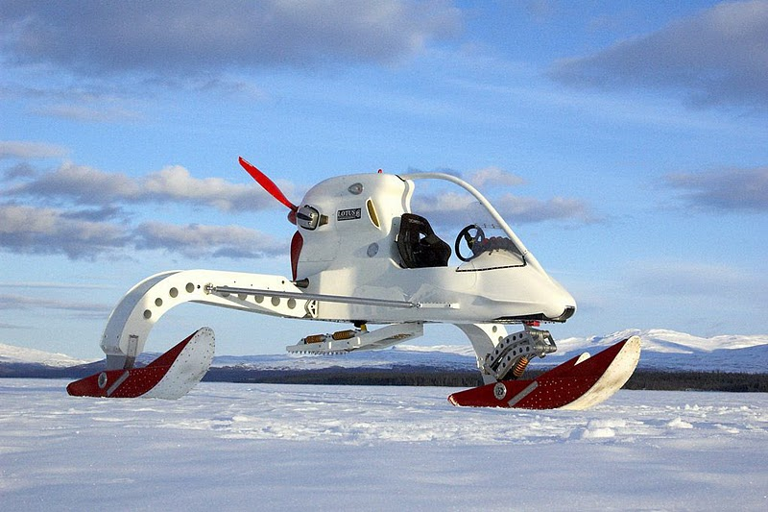
Image Boards

Slide 2
A few points to note!
In the next few slides you will see 3 pages. These pages are filled with randomly selected images
Given a brief or a design problem to solve; One can draw inspiration from each image board for designing an artefact .
Why do this?
The whole purpose of using an image board is to generate various different solutions to the one problem

Slide 3
The process allows you to work through ideas in an unstructured way.
This technique is intended to broaden a pupils creativity and design capability.
And Remember!
You can subtly reflect your inspiration(s) in the design, it doesn’t have to be taken directly from the board. The images may simply spark off an idea for you!

Slide 4



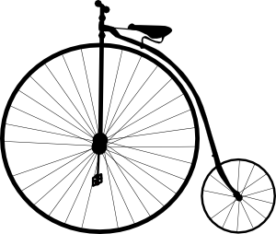



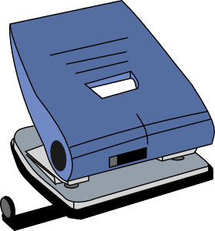
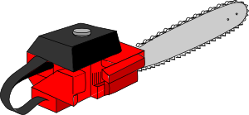


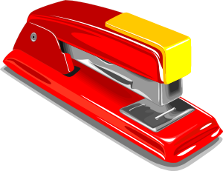

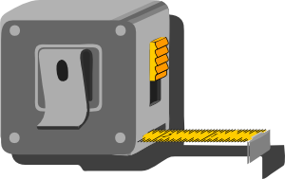
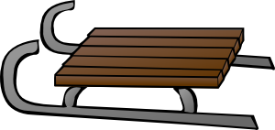

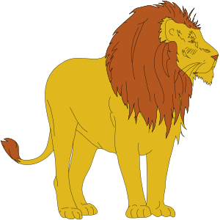

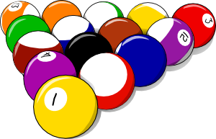

Slide 5
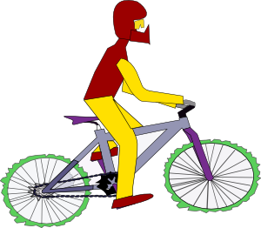













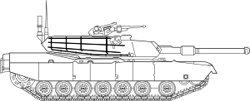

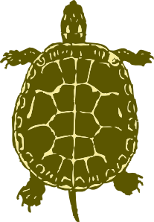
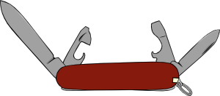


Slide 6
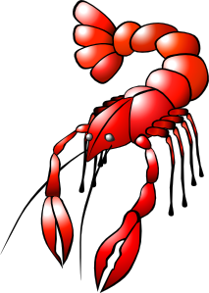






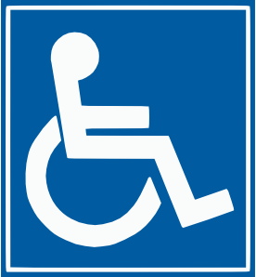








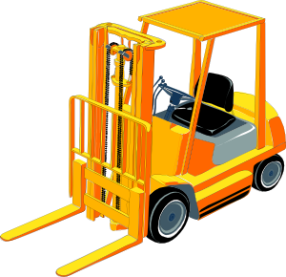
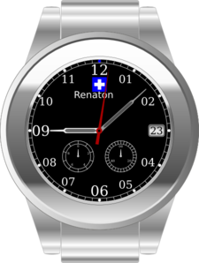


Slide 7


Instructions to teacher:
1.Hand out one image board to each pupil in the class or small groups of pupils.
2. Call out the problem to be solved (or the actual engineering brief).
3. Each member of the group must come up with their own individual designs, drawing inspiration from the image board.
4. Next all the members of the group combine their ideas, discuss and sketch the best solution.
5. Conduct a class discussion whereby the pupils present their solutions and bounce ideas off each other.
**For the Leaving Cert Brief this activity can be used by pupils individually.
Of course, you can create your own image boards.

Slide 8
Activities!
Using the image boards; create the most innovative design you can to solve the following problems:
A local toy company has asked you to come up with an educational toy for children to develop hand/eye coordination. Use an image board to find inspiration for your design.
Design an automatic animal feeder (choose animal) using inspiration from the image boards.
The elderly are a common target audience for designers. Equipment that help them with whatever ailments they may have are constantly introduced to the market. Using inspiration from the image board, design a product that may be beneficial for the elderly.
Obesity is a growing problem for the people of Ireland nowadays. Yet exercise machines can be boring to use. Using the image boards provided, design a new piece of exercise equipment that is fun to use.

